Slide 1
CANCER DEATHS

Slide 2
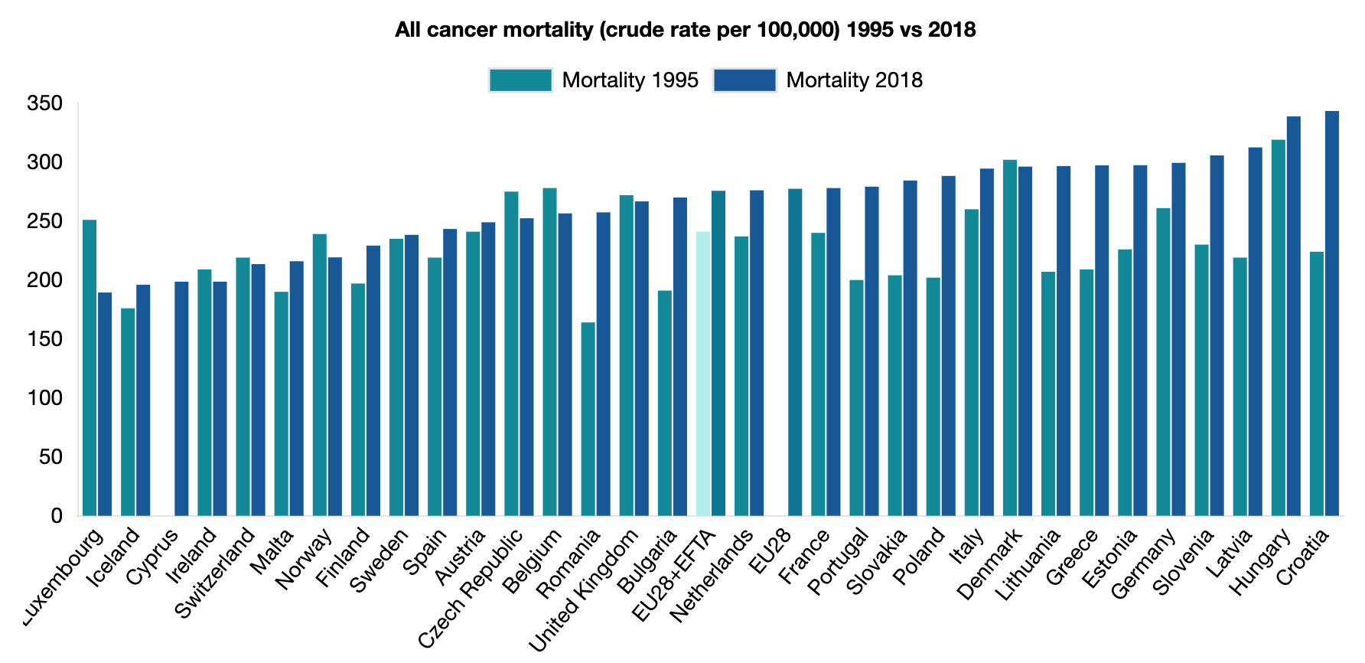
ALL CANCER MORTALITY 1995 vs 2018
In line with incidence, cancer mortality has also increased over the past two decades although at a slower pace. For some countries cancer mortality rates are even declining.
Hofmarcher, T et al. (2019) Comparator Report on Cancer in Europe 2019 - Disease Burden, Costs and Access to Medicines. IHE Report 2019:7. IHE: Lund, Sweden. For further information, please follow: https://efpia.eu/cancer-comparator-report/

Slide 3
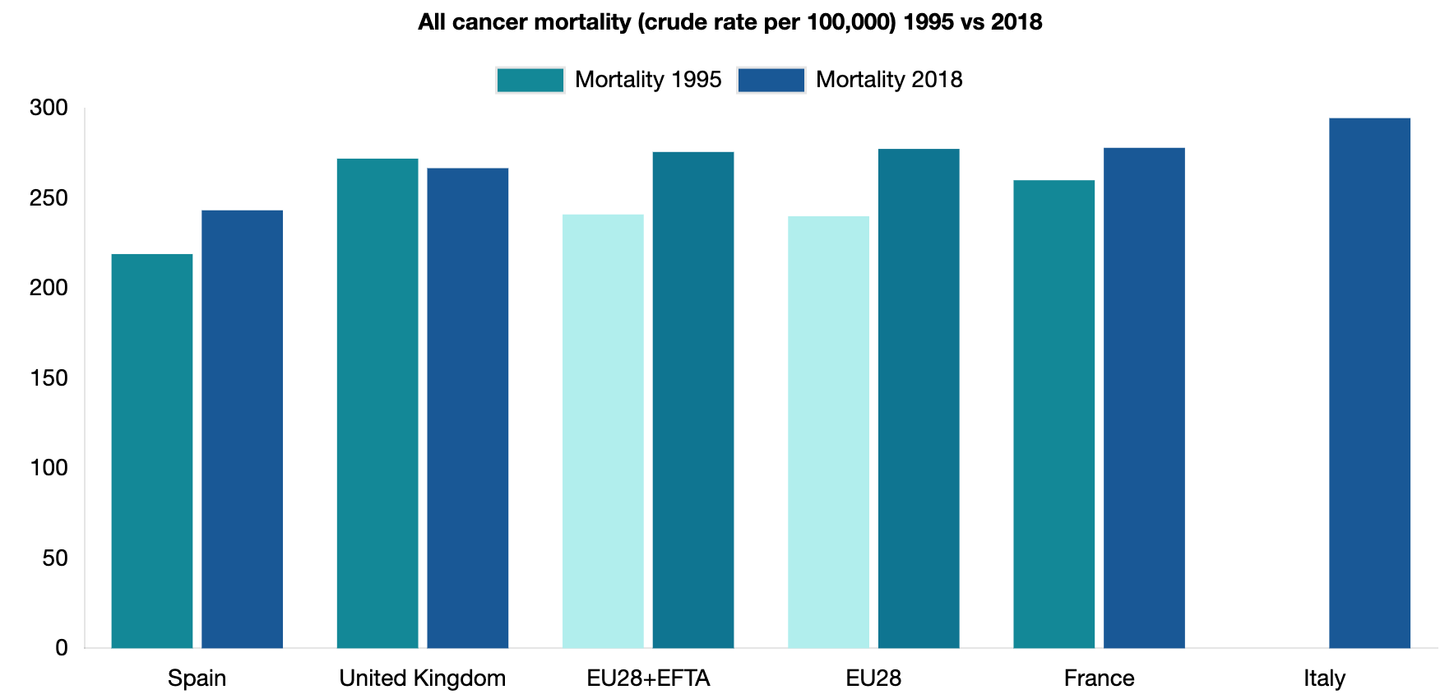
ALL CANCER MORTALITY 1995 vs 2018
In line with incidence, cancer mortality has also increased over the past two decades although at a slower pace. For some countries cancer mortality rates are even declining.
Hofmarcher, T et al. (2019) Comparator Report on Cancer in Europe 2019 - Disease Burden, Costs and Access to Medicines. IHE Report 2019:7. IHE: Lund, Sweden. For further information, please follow: https://efpia.eu/cancer-comparator-report/

Slide 4
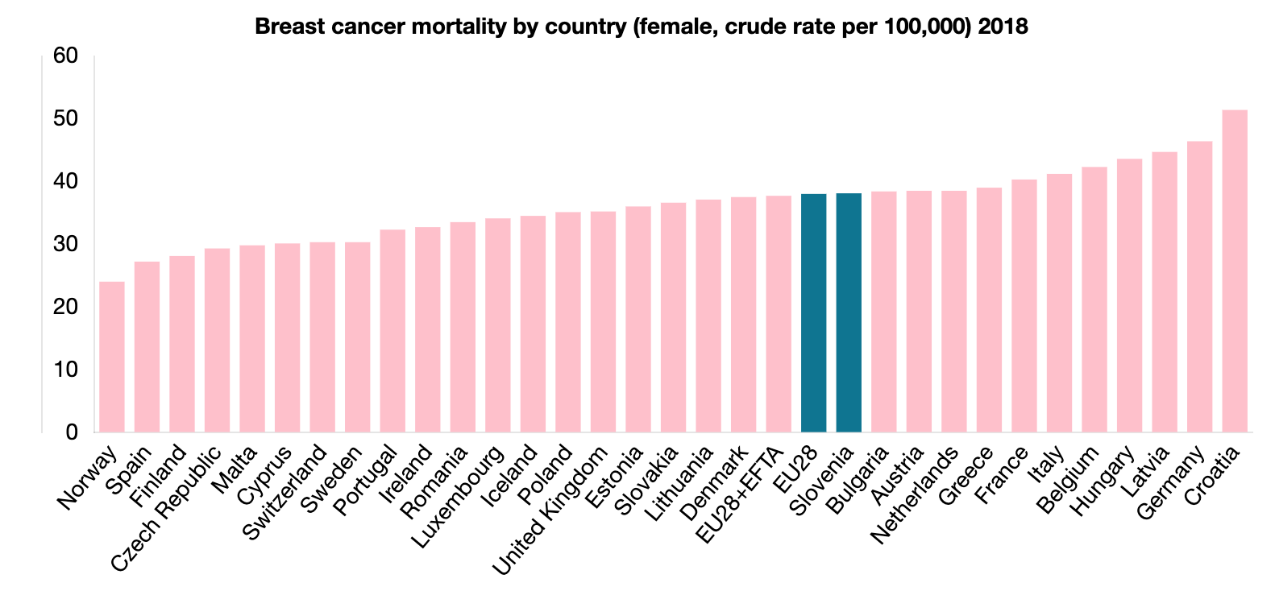
Breast Cancer Mortality
In 2018, breast cancer mortality ranged from 24 cases per 100,000 inhabitants in Norway and 51.4 in Croatia, with the EU28+EFTA average at 37.7.
Hofmarcher, T et al. (2019) Comparator Report on Cancer in Europe 2019 - Disease Burden, Costs and Access to Medicines. IHE Report 2019:7. IHE: Lund, Sweden. For further information, please follow: https://efpia.eu/cancer-comparator-report/

Slide 5
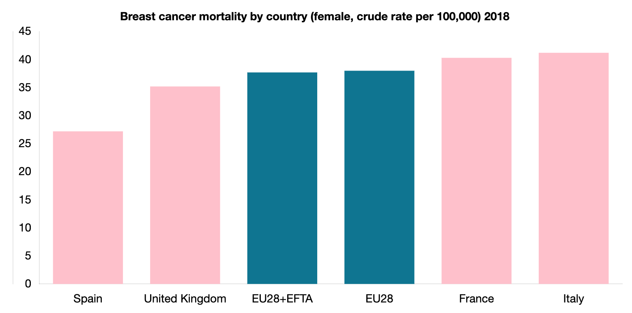
Breast Cancer Mortality
In 2018, breast cancer mortality ranged from 24 cases per 100,000 inhabitants in Norway and 51.4 in Croatia, with the EU28+EFTA average at 37.7.
Hofmarcher, T et al. (2019) Comparator Report on Cancer in Europe 2019 - Disease Burden, Costs and Access to Medicines. IHE Report 2019:7. IHE: Lund, Sweden. For further information, please follow: https://efpia.eu/cancer-comparator-report/

Slide 6
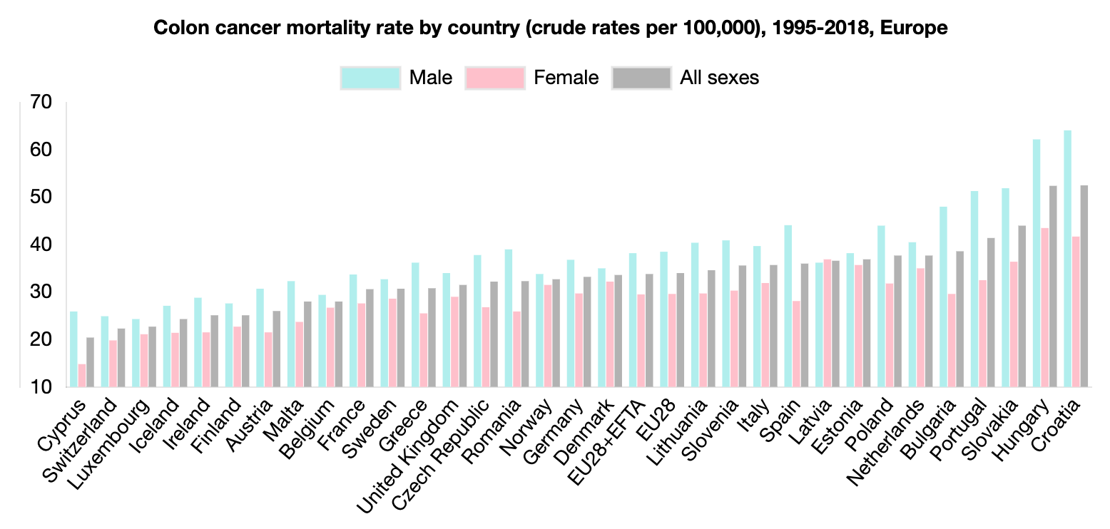
Colon Cancer Mortality
In 2018, colorectal cancer mortality for women ranged from 14.8 per 100,000 in Cyprus to 43.5 in Hungary, with the EU28+EFTA average at 29.5. For men, mortality ranged from 24.3 per 100,000 in Luxembourg to 64.1 in Croatia, with the EU28+EFTA average at 38.2.
Hofmarcher, T et al. (2019) Comparator Report on Cancer in Europe 2019 - Disease Burden, Costs and Access to Medicines. IHE Report 2019:7. IHE: Lund, Sweden. For further information, please follow: https://efpia.eu/cancer-comparator-report/

Slide 7
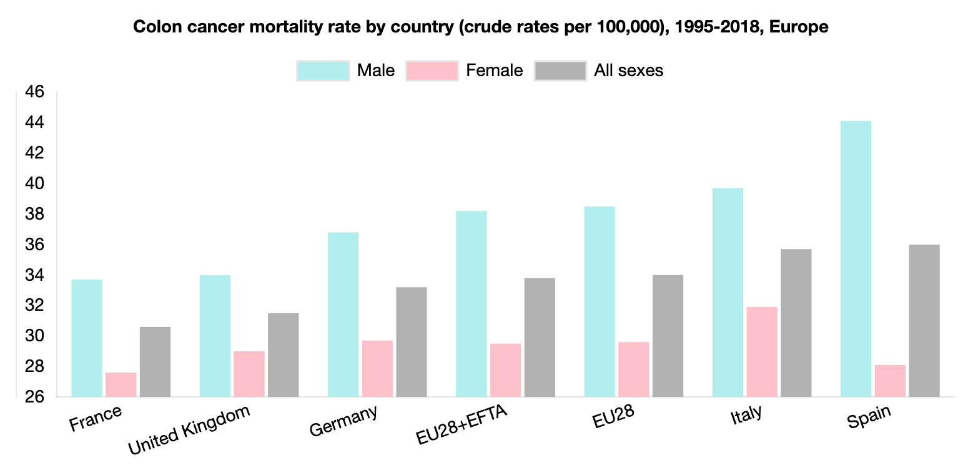
Colon Cancer Mortality
In 2018, colorectal cancer mortality for women ranged from 14.8 per 100,000 in Cyprus to 43.5 in Hungary, with the EU28+EFTA average at 29.5. For men, mortality ranged from 24.3 per 100,000 in Luxembourg to 64.1 in Croatia, with the EU28+EFTA average at 38.2.
Hofmarcher, T et al. (2019) Comparator Report on Cancer in Europe 2019 - Disease Burden, Costs and Access to Medicines. IHE Report 2019:7. IHE: Lund, Sweden. For further information, please follow: https://efpia.eu/cancer-comparator-report/

Slide 8
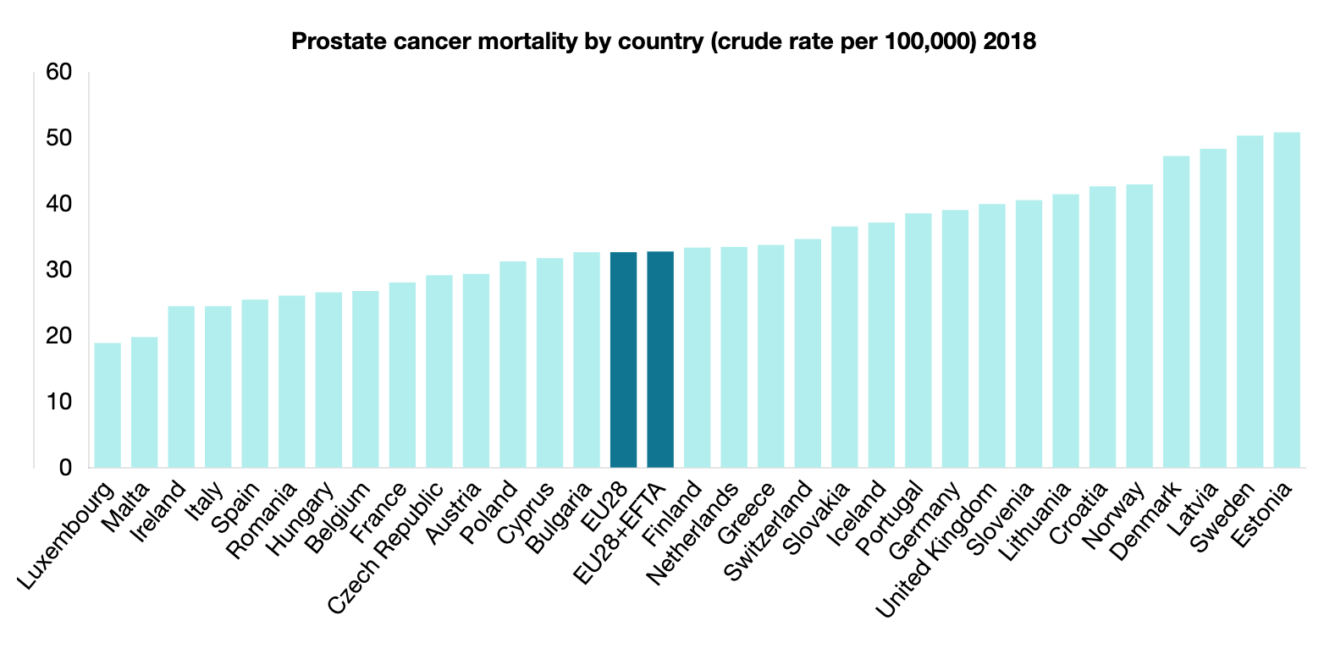
Prostate Cancer Mortality
In 2018, prostate cancer mortality ranged from 50.9 of 100,000 inhabitants in Estonia to 18.9 in Luxembourg, with the EU28+EFTA average at 32.8.
Hofmarcher, T et al. (2019) Comparator Report on Cancer in Europe 2019 - Disease Burden, Costs and Access to Medicines. IHE Report 2019:7. IHE: Lund, Sweden. For further information, please follow: https://efpia.eu/cancer-comparator-report/

Slide 9
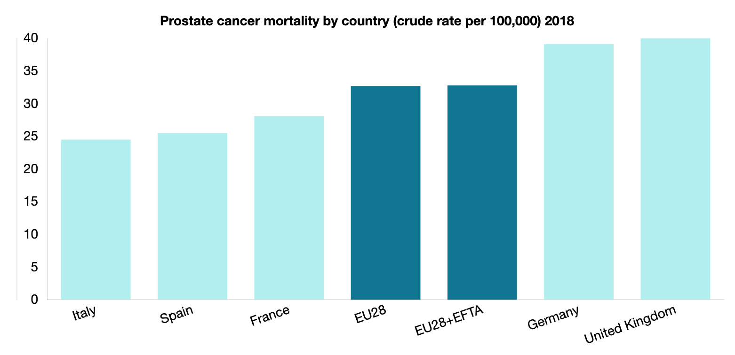
Prostate Cancer Mortality
In 2018, prostate cancer mortality ranged from 50.9 of 100,000 inhabitants in Estonia to 18.9 in Luxembourg, with the EU28+EFTA average at 32.8.
Hofmarcher, T et al. (2019) Comparator Report on Cancer in Europe 2019 - Disease Burden, Costs and Access to Medicines. IHE Report 2019:7. IHE: Lund, Sweden. For further information, please follow: https://efpia.eu/cancer-comparator-report/

Slide 10
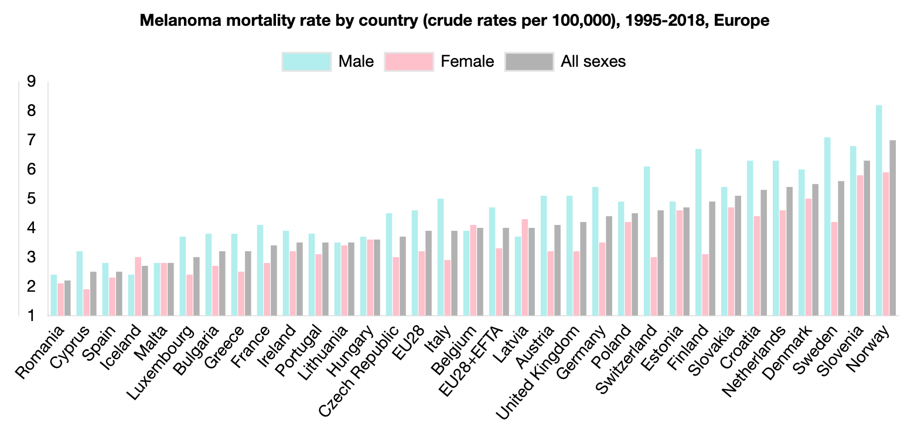
Melanoma Mortality
In 2018, melanoma mortality for women ranged from 1.9 cases per 100,000 inhabitants in Cyprus to 5.9 in Norway, with the EU28+EFTA average at 3.3. For men, it ranged from 2.4 in Iceland and Romania to 8.2 in Norway, with the EU28+EFTA average at 4.7.
Hofmarcher, T et al. (2019) Comparator Report on Cancer in Europe 2019 - Disease Burden, Costs and Access to Medicines. IHE Report 2019:7. IHE: Lund, Sweden. For further information, please follow: https://efpia.eu/cancer-comparator-report/

Slide 11
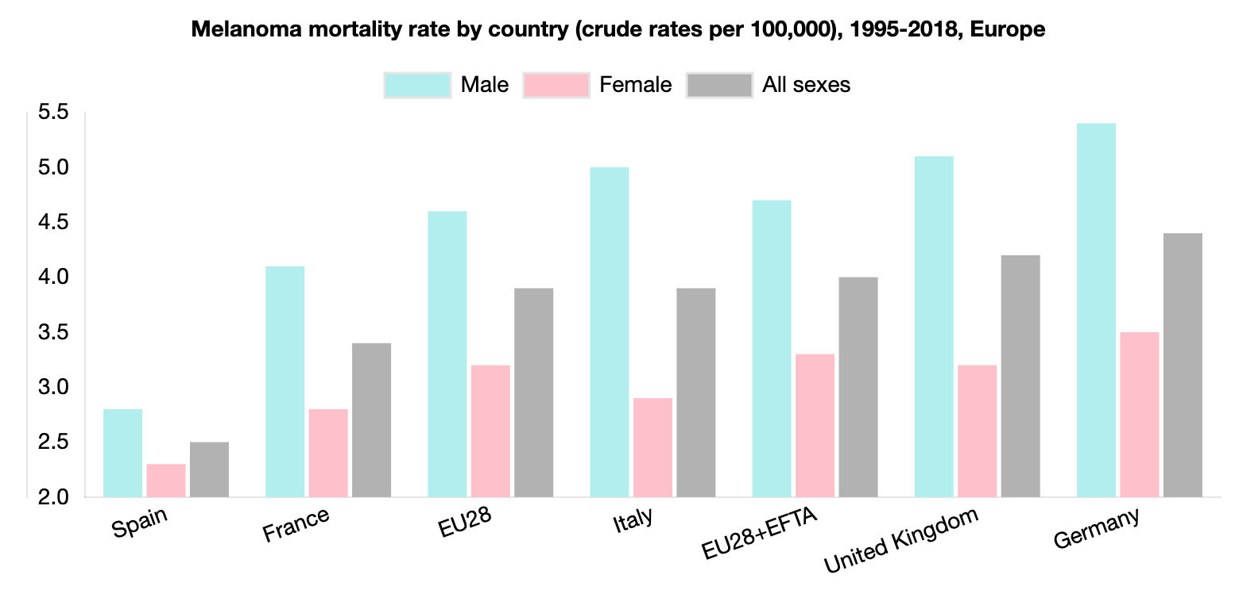
Melanoma Mortality
In 2018, melanoma mortality for women ranged from 1.9 cases per 100,000 inhabitants in Cyprus to 5.9 in Norway, with the EU28+EFTA average at 3.3. For men, it ranged from 2.4 in Iceland and Romania to 8.2 in Norway, with the EU28+EFTA average at 4.7.
Hofmarcher, T et al. (2019) Comparator Report on Cancer in Europe 2019 - Disease Burden, Costs and Access to Medicines. IHE Report 2019:7. IHE: Lund, Sweden. For further information, please follow: https://efpia.eu/cancer-comparator-report/

Slide 12
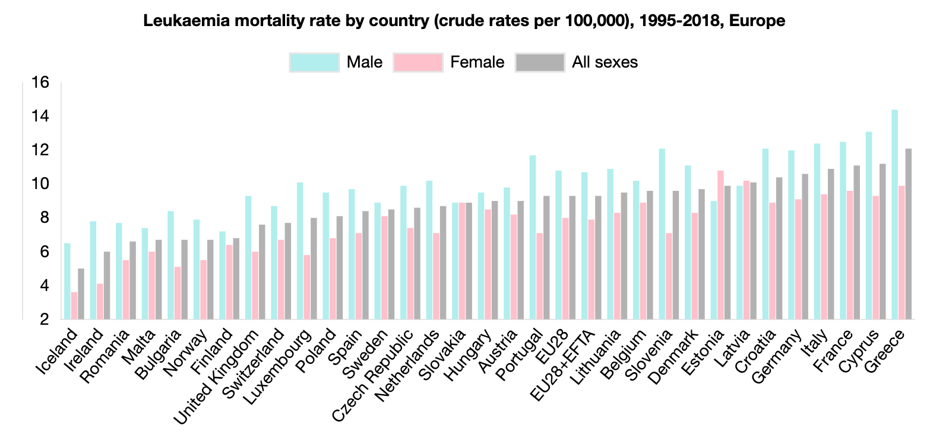
Leukaemia Mortality
In 2018, leukaemia mortality for women ranged from 3.6 cases per 100,000 inhabitants in Iceland to 10.8 in Estonia, with the EU28+EFTA average at 7.9. For men, it ranged from 6.5 in Iceland and 14.4 in Greece, with the EU28+EFTA average at 10.7.
Hofmarcher, T et al. (2019) Comparator Report on Cancer in Europe 2019 - Disease Burden, Costs and Access to Medicines. IHE Report 2019:7. IHE: Lund, Sweden. For further information, please follow: https://efpia.eu/cancer-comparator-report/

Slide 13
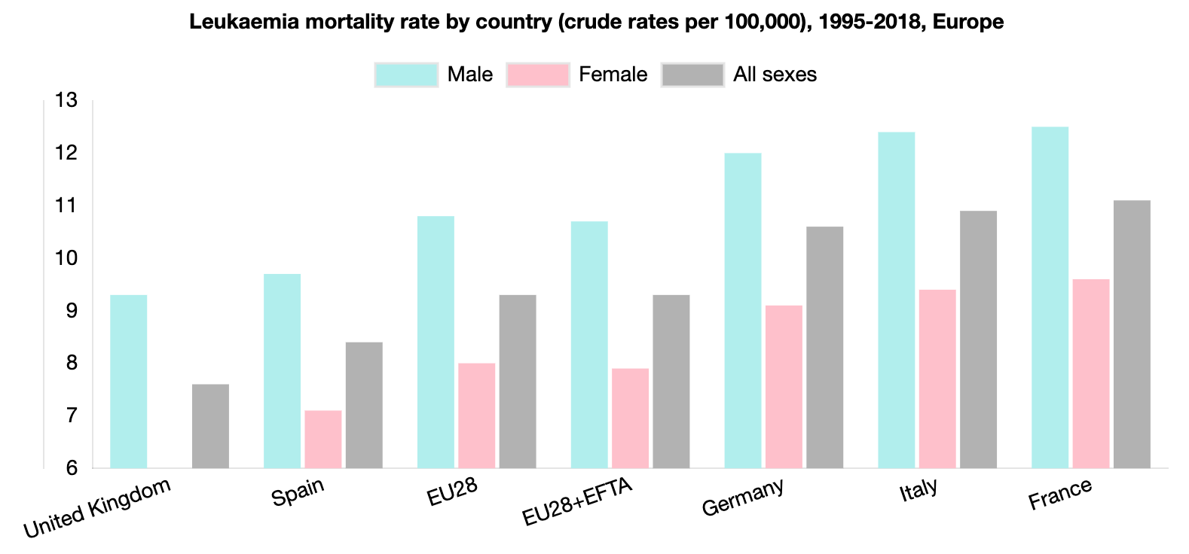
Leukaemia Mortality
In 2018, leukaemia mortality for women ranged from 3.6 cases per 100,000 inhabitants in Iceland to 10.8 in Estonia, with the EU28+EFTA average at 7.9. For men, it ranged from 6.5 in Iceland and 14.4 in Greece, with the EU28+EFTA average at 10.7.
Hofmarcher, T et al. (2019) Comparator Report on Cancer in Europe 2019 - Disease Burden, Costs and Access to Medicines. IHE Report 2019:7. IHE: Lund, Sweden. For further information, please follow: https://efpia.eu/cancer-comparator-report/

Slide 14
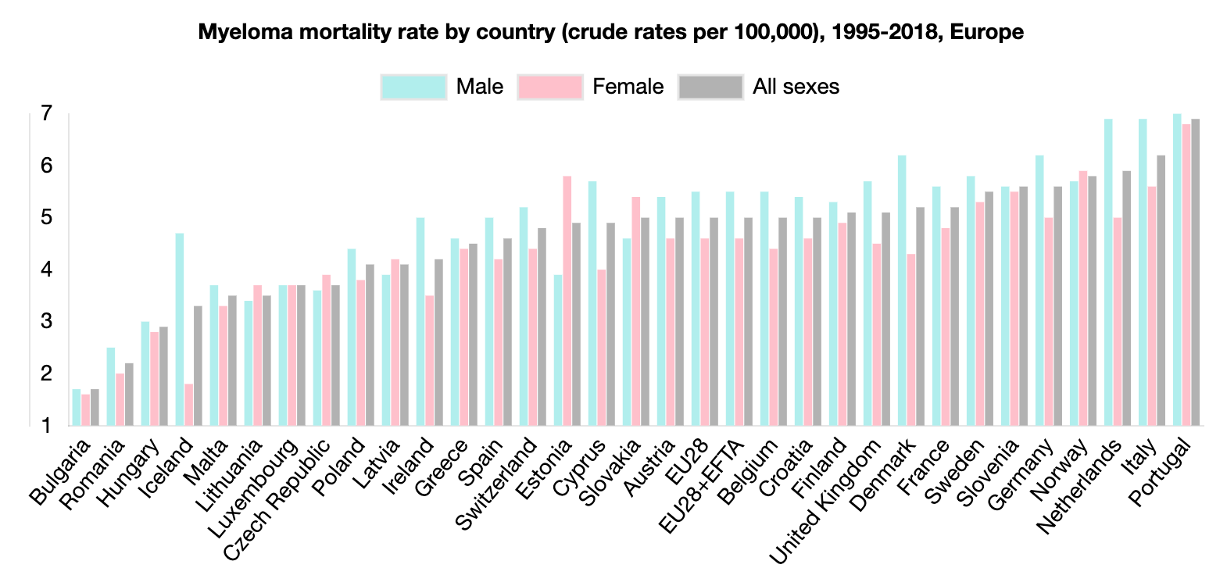
Multiple myeloma mortality
In 2018, multiple myeloma mortality for females ranged from 1.6 cases per 100,000 inhabitants in Bulgaria to 6.8 in Portugal, with the EU28+EFTA average at 4.6. For males, it ranged from 1.7 in Bulgaria to 6.9 in the Netherlands and Italy, with the EU28+EFTA average at 5.5.
Hofmarcher, T et al. (2019) Comparator Report on Cancer in Europe 2019 - Disease Burden, Costs and Access to Medicines. IHE Report 2019:7. IHE: Lund, Sweden. For further information, please follow: https://efpia.eu/cancer-comparator-report/

Slide 15
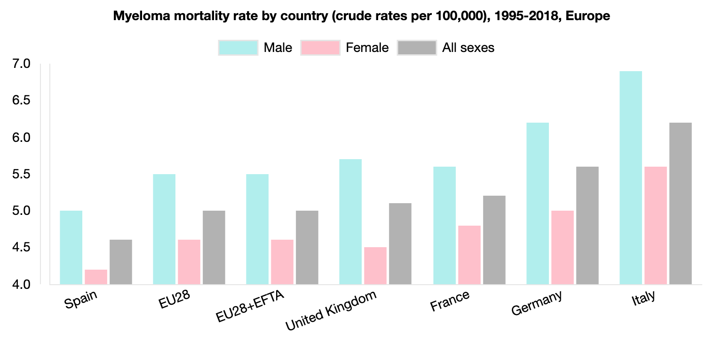
Multiple myeloma mortality
In 2018, multiple myeloma mortality for females ranged from 1.6 cases per 100,000 inhabitants in Bulgaria to 6.8 in Portugal, with the EU28+EFTA average at 4.6. For males, it ranged from 1.7 in Bulgaria to 6.9 in the Netherlands and Italy, with the EU28+EFTA average at 5.5.
Hofmarcher, T et al. (2019) Comparator Report on Cancer in Europe 2019 - Disease Burden, Costs and Access to Medicines. IHE Report 2019:7. IHE: Lund, Sweden. For further information, please follow: https://efpia.eu/cancer-comparator-report/

Slide 16
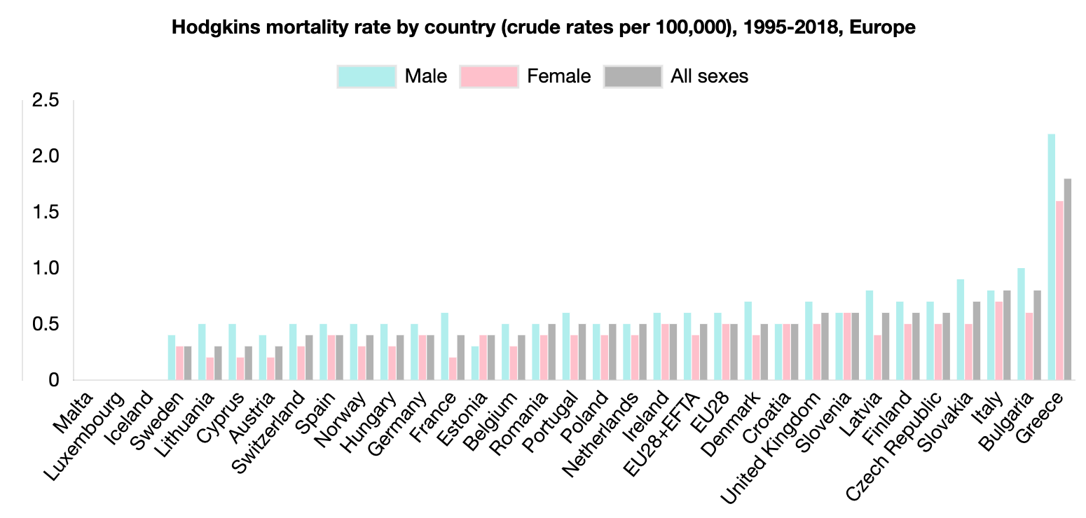
Hodgkin’s lymphoma mortality
In 2018, Hodgkin’s lymphoma mortality for females ranged from 0 cases per 100,000 inhabitants in Iceland, Luxembourg and Malta to 1.6 in Greece, with the EU28+EFTA average at 0.4. For males, it ranged from 0 in Iceland, Luxembourg and Malta to 2.2 in Greece, with the EU28+EFTA average at 0.6.
Hofmarcher, T et al. (2019) Comparator Report on Cancer in Europe 2019 - Disease Burden, Costs and Access to Medicines. IHE Report 2019:7. IHE: Lund, Sweden. For further information, please follow: https://efpia.eu/cancer-comparator-report/

Slide 17
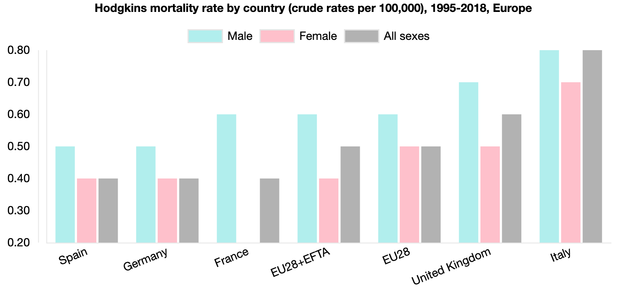
Hodgkin’s lymphoma mortality
In 2018, Hodgkin’s lymphoma mortality for females ranged from 0 cases per 100,000 inhabitants in Iceland, Luxembourg and Malta to 1.6 in Greece, with the EU28+EFTA average at 0.4. For males, it ranged from 0 in Iceland, Luxembourg and Malta to 2.2 in Greece, with the EU28+EFTA average at 0.6.
Hofmarcher, T et al. (2019) Comparator Report on Cancer in Europe 2019 - Disease Burden, Costs and Access to Medicines. IHE Report 2019:7. IHE: Lund, Sweden. For further information, please follow: https://efpia.eu/cancer-comparator-report/

Slide 18
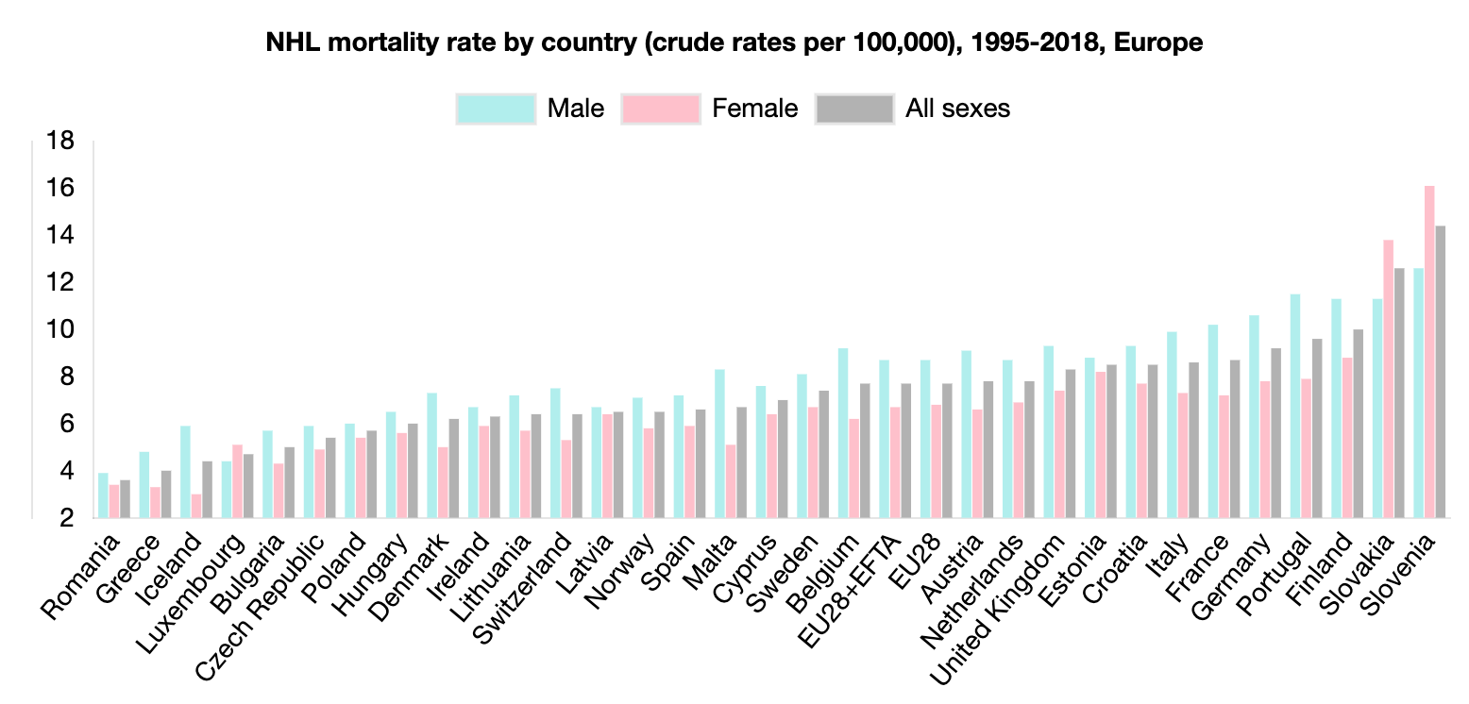
Non-Hodgkin’s lymphoma mortality
In 2018, Non-Hodgkin’s lymphoma mortality for females ranged from 3 cases per 100,000 inhabitants in Iceland to 16.1 in Slovenia, with the EU28+EFTA average at 6.7. For males, it ranged from 3.9 in Romania to 12.6 in Slovenia, with the EU28+EFTA average at 8.7.
Hofmarcher, T et al. (2019) Comparator Report on Cancer in Europe 2019 - Disease Burden, Costs and Access to Medicines. IHE Report 2019:7. IHE: Lund, Sweden. For further information, please follow: https://efpia.eu/cancer-comparator-report/

Slide 19
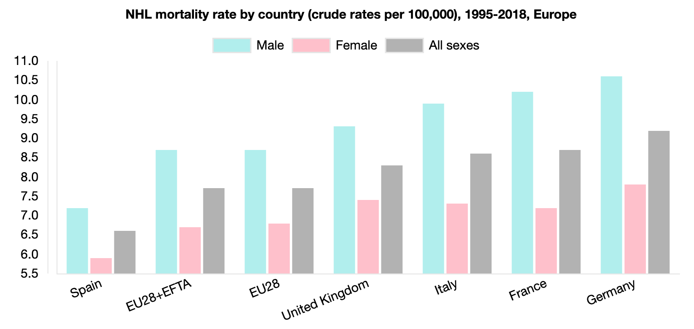
Non-Hodgkin’s lymphoma mortality
In 2018, Non-Hodgkin’s lymphoma mortality for females ranged from 3 cases per 100,000 inhabitants in Iceland to 16.1 in Slovenia, with the EU28+EFTA average at 6.7. For males, it ranged from 3.9 in Romania to 12.6 in Slovenia, with the EU28+EFTA average at 8.7.
Hofmarcher, T et al. (2019) Comparator Report on Cancer in Europe 2019 - Disease Burden, Costs and Access to Medicines. IHE Report 2019:7. IHE: Lund, Sweden. For further information, please follow: https://efpia.eu/cancer-comparator-report/

Slide 20
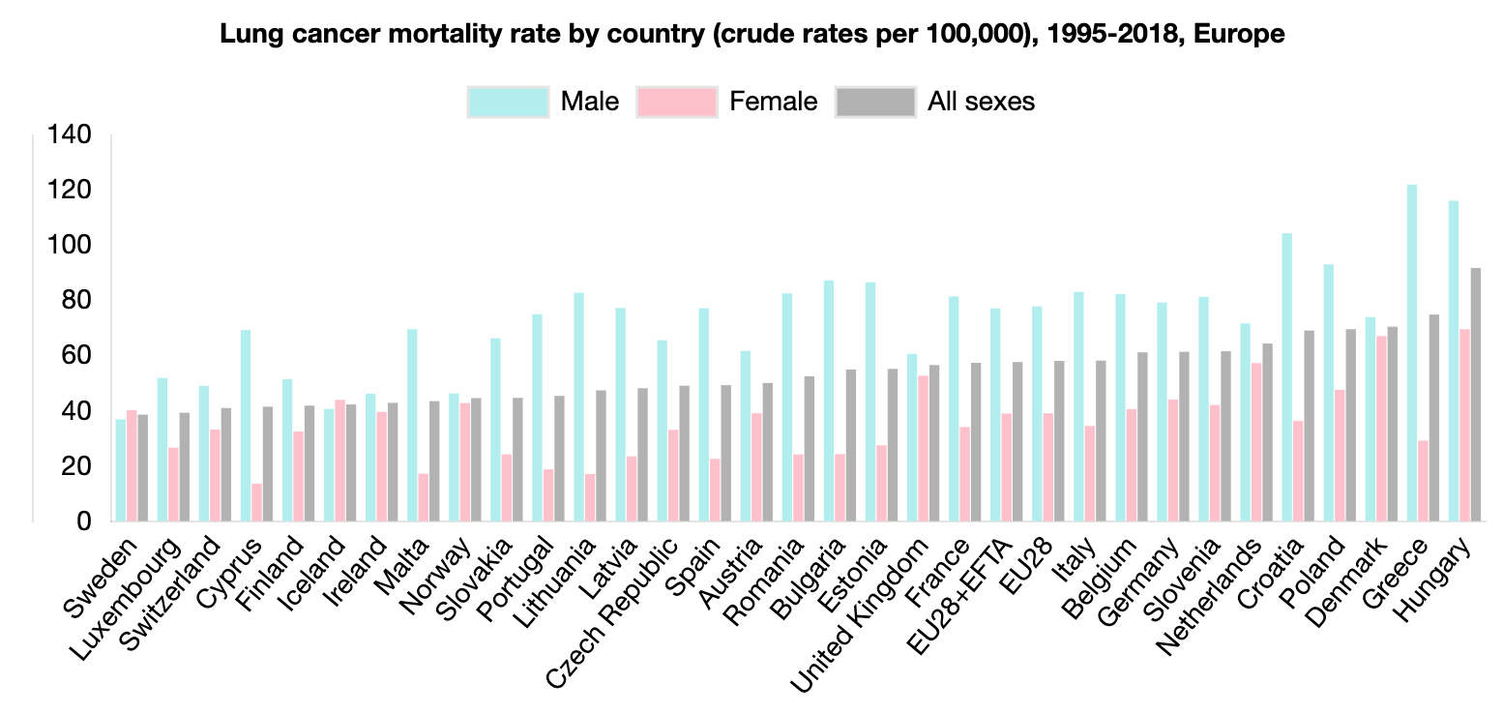
Lung Cancer Mortality
In 2018, lung cancer mortality for women ranged from 13.6 cases per 100,000 inhabitants in Cyprus to 69.6 in Hungary, with the EU28+EFTA average at 39. For men, mortality ranged from 36.9 in Sweden to 122 in Greece, with the EU28+EFTA average at 77.1.
Hofmarcher, T et al. (2019) Comparator Report on Cancer in Europe 2019 - Disease Burden, Costs and Access to Medicines. IHE Report 2019:7. IHE: Lund, Sweden. For further information, please follow: https://efpia.eu/cancer-comparator-report/

Slide 21
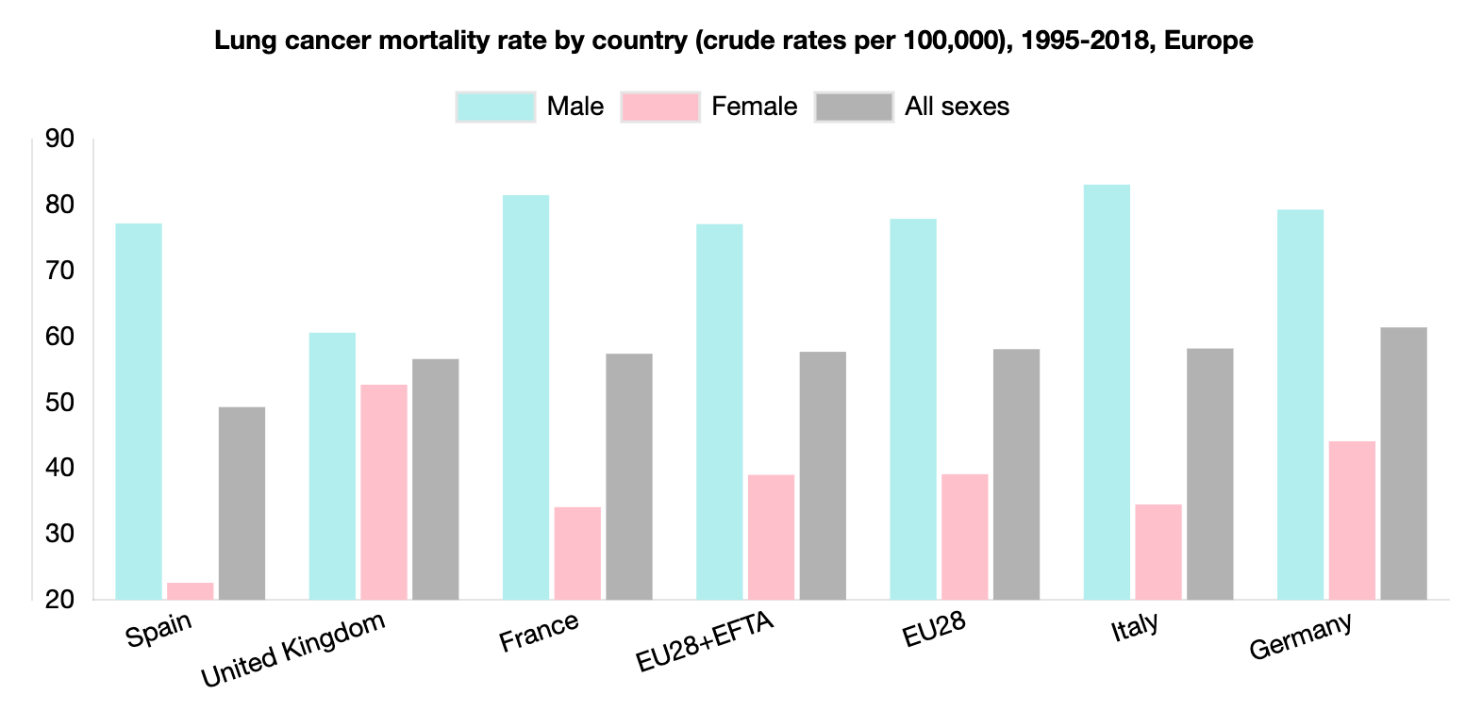
Lung Cancer Mortality
In 2018, lung cancer mortality for women ranged from 13.6 cases per 100,000 inhabitants in Cyprus to 69.6 in Hungary, with the EU28+EFTA average at 39. For men, mortality ranged from 36.9 in Sweden to 122 in Greece, with the EU28+EFTA average at 77.1.
Hofmarcher, T et al. (2019) Comparator Report on Cancer in Europe 2019 - Disease Burden, Costs and Access to Medicines. IHE Report 2019:7. IHE: Lund, Sweden. For further information, please follow: https://efpia.eu/cancer-comparator-report/

Slide 22
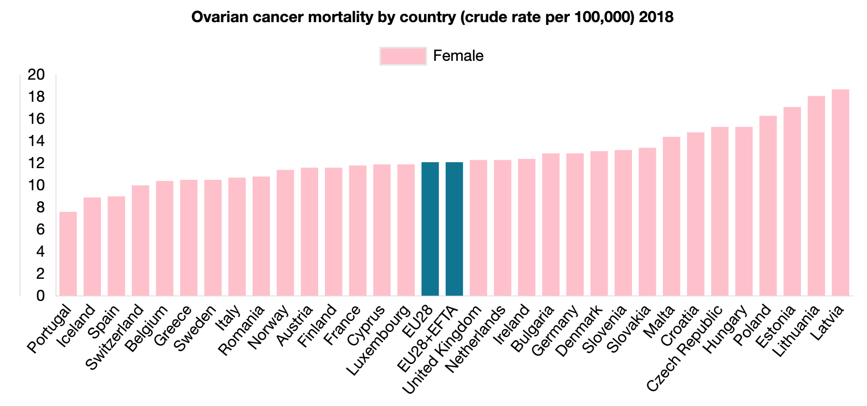
Ovarian Cancer Mortality
In 2018, ovarian cancer mortality ranged from 7.6 cases per 100,000 inhabitants in Portugal to 18.7 in Latvia, with the EU28+EFTA average at 12.1.
Hofmarcher, T et al. (2019) Comparator Report on Cancer in Europe 2019 - Disease Burden, Costs and Access to Medicines. IHE Report 2019:7. IHE: Lund, Sweden. For further information, please follow: https://efpia.eu/cancer-comparator-report/

Slide 23
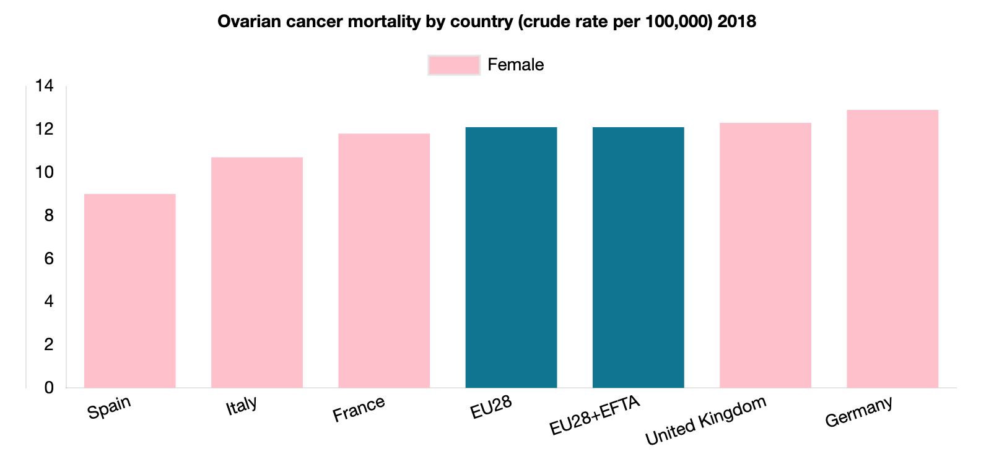
Ovarian Cancer Mortality
In 2018, ovarian cancer mortality ranged from 7.6 cases per 100,000 inhabitants in Portugal to 18.7 in Latvia, with the EU28+EFTA average at 12.1.
Hofmarcher, T et al. (2019) Comparator Report on Cancer in Europe 2019 - Disease Burden, Costs and Access to Medicines. IHE Report 2019:7. IHE: Lund, Sweden. For further information, please follow: https://efpia.eu/cancer-comparator-report/

Slide 24
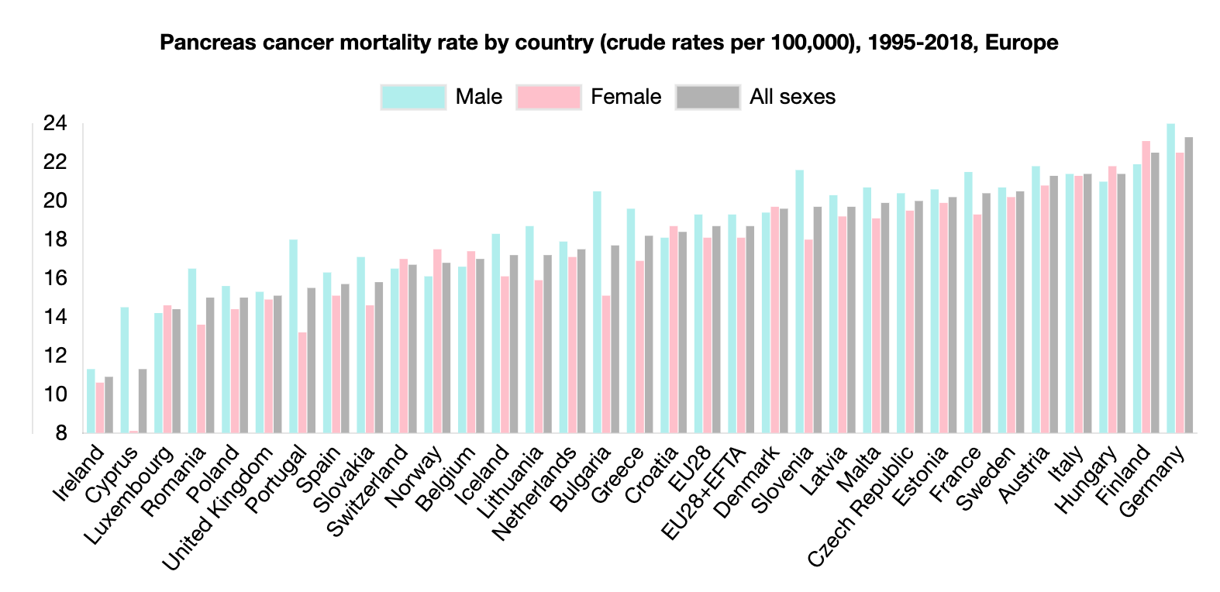
Pancreatic Cancer Mortality
In 2018, pancreatic cancer mortality for women ranged from 8.1 cases per 100,000 inhabitants in Cyprus to 23.1 in Finland, with the EU28+EFTA average at 18.1. For men, it ranged from 11.3 in Ireland to 24 in Germany, with the EU28+EFTA average at 19.3.
Hofmarcher, T et al. (2019) Comparator Report on Cancer in Europe 2019 - Disease Burden, Costs and Access to Medicines. IHE Report 2019:7. IHE: Lund, Sweden. For further information, please follow: https://efpia.eu/cancer-comparator-report/

Slide 25
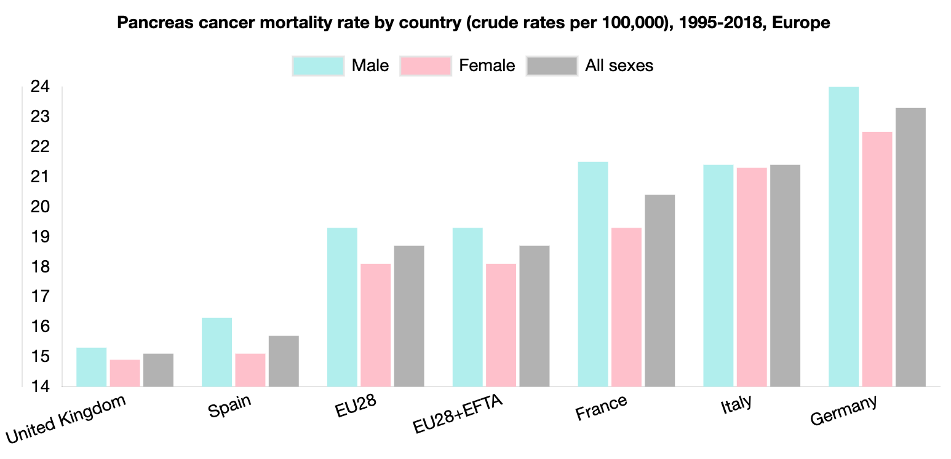
Pancreatic Cancer Mortality
In 2018, pancreatic cancer mortality for women ranged from 8.1 cases per 100,000 inhabitants in Cyprus to 23.1 in Finland, with the EU28+EFTA average at 18.1. For men, it ranged from 11.3 in Ireland to 24 in Germany, with the EU28+EFTA average at 19.3.
Hofmarcher, T et al. (2019) Comparator Report on Cancer in Europe 2019 - Disease Burden, Costs and Access to Medicines. IHE Report 2019:7. IHE: Lund, Sweden. For further information, please follow: https://efpia.eu/cancer-comparator-report/

