Slide 1
Unlocking the Power of the Genome Personalized Medicine in the Era of Big Data
EFPIA Annual Meeting
Luxembourg
June 5 2015
Simon Valentine
Executive TAM

Slide 2
Agenda
An Introduction to Illumina
Next-generation sequencing – rapid evolutions towards personalized medicine
Big Data Informatics – Current SOP, Challenges & Future Perspectives

Slide 3
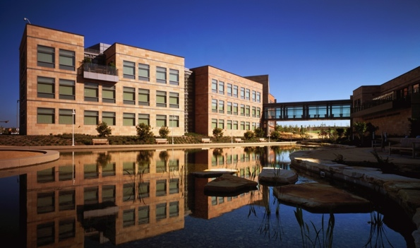
Our Background Leading innovation regionally and globally
Founded Fall 1998
IPO July 27, 2000
Headquartered in San Diego, CA
>3,750 employees
20 offices globally
Financials
2013 Revenue: $1.4B
24% growth year over year
Scientists’ Choice Awards
Best New Clinical Laboratory Product, Illumina MiSeqDX System
2013
Forbes
The 12 Most Disruptive Names in Business
2013
Forbes
Fastest Growing Tech Companies
2010
MIT Technology Review 10 Breakthrough Technologies
2013
MIT Technology Review Smartest Company
2014
The Scientist Magazine Top 10 Innovations
2012

Slide 4
Population Sequencing is Here Illumina will sequence 100,000 genomes for Genomics England
Genomics England hopes to transform diagnosis and treatment of cancer and rare diseases
Over 4 years, Illumina will sequence 100,000 patient and cancer genomes from U.K. National Health Service

Slide 5
Our Vision
Advance Human Health by Unlocking the Power of the Genome.

Slide 6
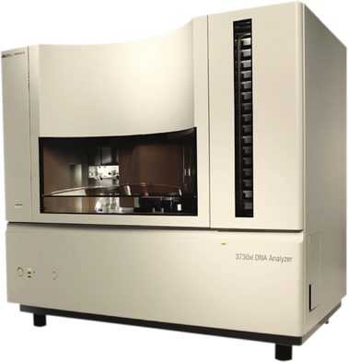
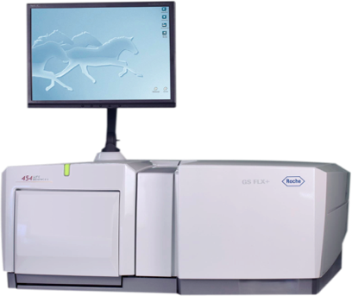
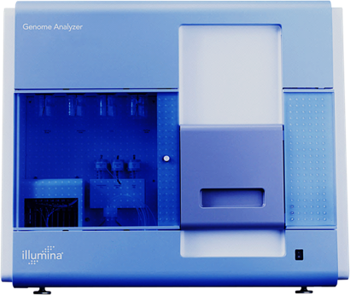
2003
2006
Human Genome
Project
1st individual
genome
$3B
$20M
2007
2008
1st NGS
genome
1st 30x
genome
$2M
$200K

Slide 7
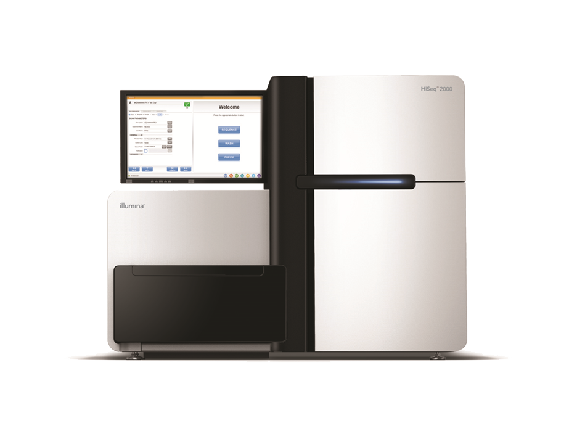
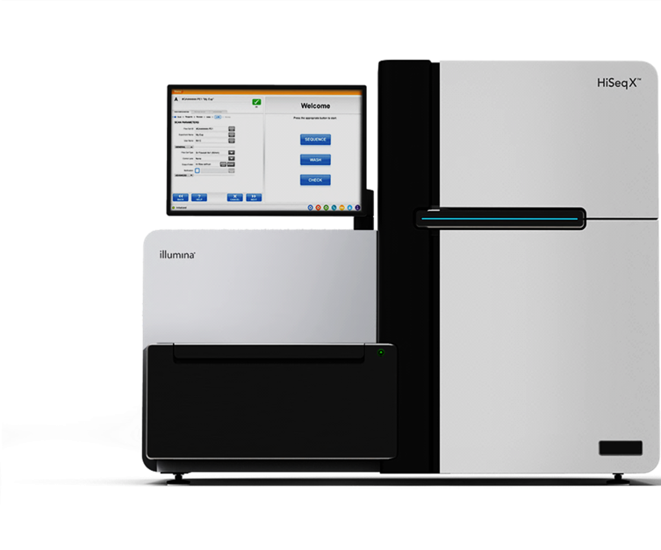
2010
2014
1st sub-
$10K
genome
1st
$1,000
genome
from $20M to $1K Human Genome 20,000x drop

Slide 8
>90% of the world’s sequencing data have been generated using Illumina sequencers.

Slide 9
Sequencing Will Be Ubiquitous
Consumer
Cancer
Genetics
Reproductive Health
Forensics
Infectious Disease
Agriculture
Research
BioPharm

Slide 10
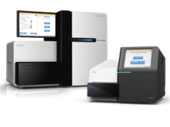
Five Key Business Units To better enable and serve our markets
Life Sciences
Core, life sciences focused products
New & Emerging Markets
Enterprise Informatics
Oncology
Reproductive & Genetic Health
Enable storing, analyzing, understanding and sharing of genomic and phenotypic information
Develop solutions across the spectrum of cancer management using our technology
Integrated genomics solutions for reproductive & genetic health
Identify & incubate new market opportunities

Slide 11
Big Data Informatics Market
Current State | Future State
DIY tool integrations the norm | Standardized workflows
Dozens of disparate software products | Secure and integrated (SaaS) solutions
Analysis infrastructure on premise | Economies of scale in regional “clouds”
Thousands of known/useful genomes | 100,000+ genomes public and private
Limited –omics per subject | Rich time series to analyze
Largely unregulated (research) | Clinical/regulated quality and robustness
Samples are analyzed by bioinformaticians | Dynamic cohort analysis widely accessible

Slide 12
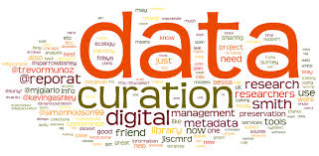
What’s Standing in the Way?
Usability
IT Infrastructure
Leverage public data
Aggregation

Slide 13
What’s in a Genome? Has the potential to change our future
Give insight into predispositions and symptoms
Help inform proactive health management and lifestyle choices
Suggest conditions for which your children might be at risk
Guide drug choices
In short, choices and care, personalized

Slide 14
“We believe that someday everybody’s going to get sequenced. Newborns will get sequenced when they’re born. And with wireless ... people will have real-time monitoring of their health.”
– Jay Flatley, 2013
San Diego Union Tribune

Slide 15
Questions? svalentine@illumina.com
“The $1,000 genome unlocks everything.”
“We finally get to crack open the book of disease.”
Eric Lander – Broad Institute
“Clinicians can selectively look for an almost unlimited number of genetic changes that may be of medical significance,” “Access to these data opens the door for the transformation of research, clinical care and patient engagement.”
Francis Collins, Director of NIH

