Slide 1

The IFPMA Code and how to set up a national self-regulation system
Presentation to China/EU Pharmaceutical Industry Forum 17 May 2017, Shanghai, China
Dr. Brendan Shaw
Assistant Director General
IFPMA
Email: b.shaw@ifpma.org
Twitter: @shaw_brendan

Slide 2

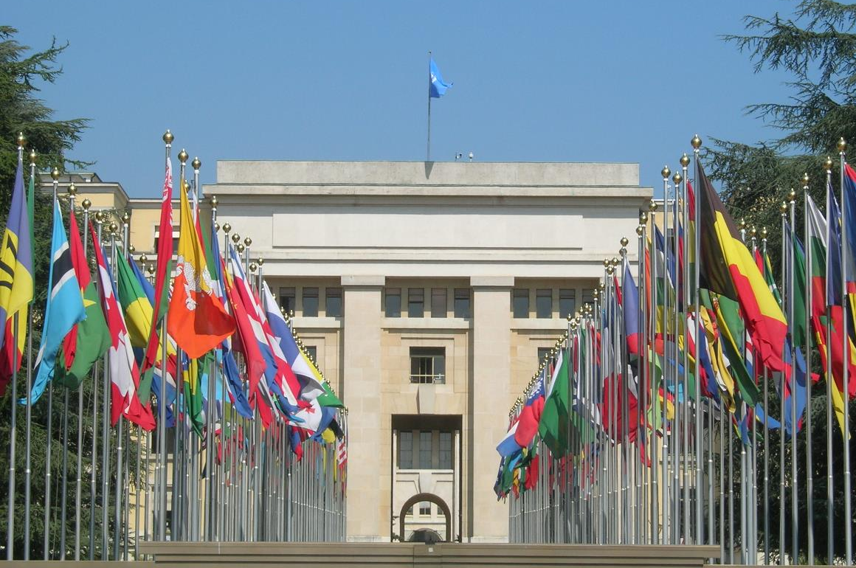
IFPMA represents research-based biopharmaceutical companies
and regional and national associations across the world

Slide 3
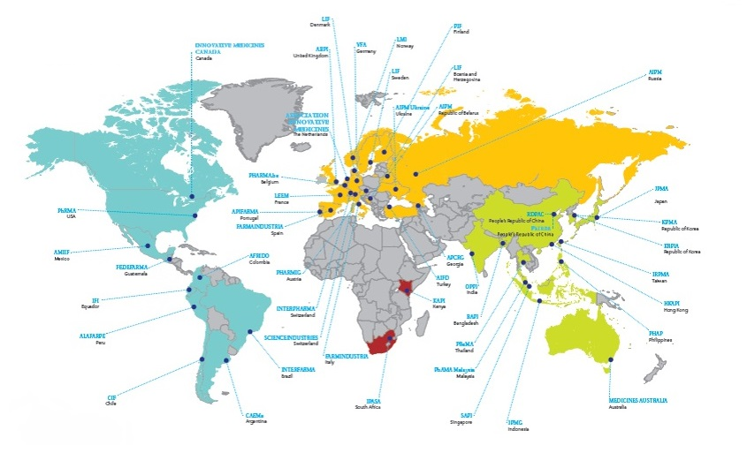
50 member associations

Slide 4

























Over 30 member companies
And more are joining …

Slide 5
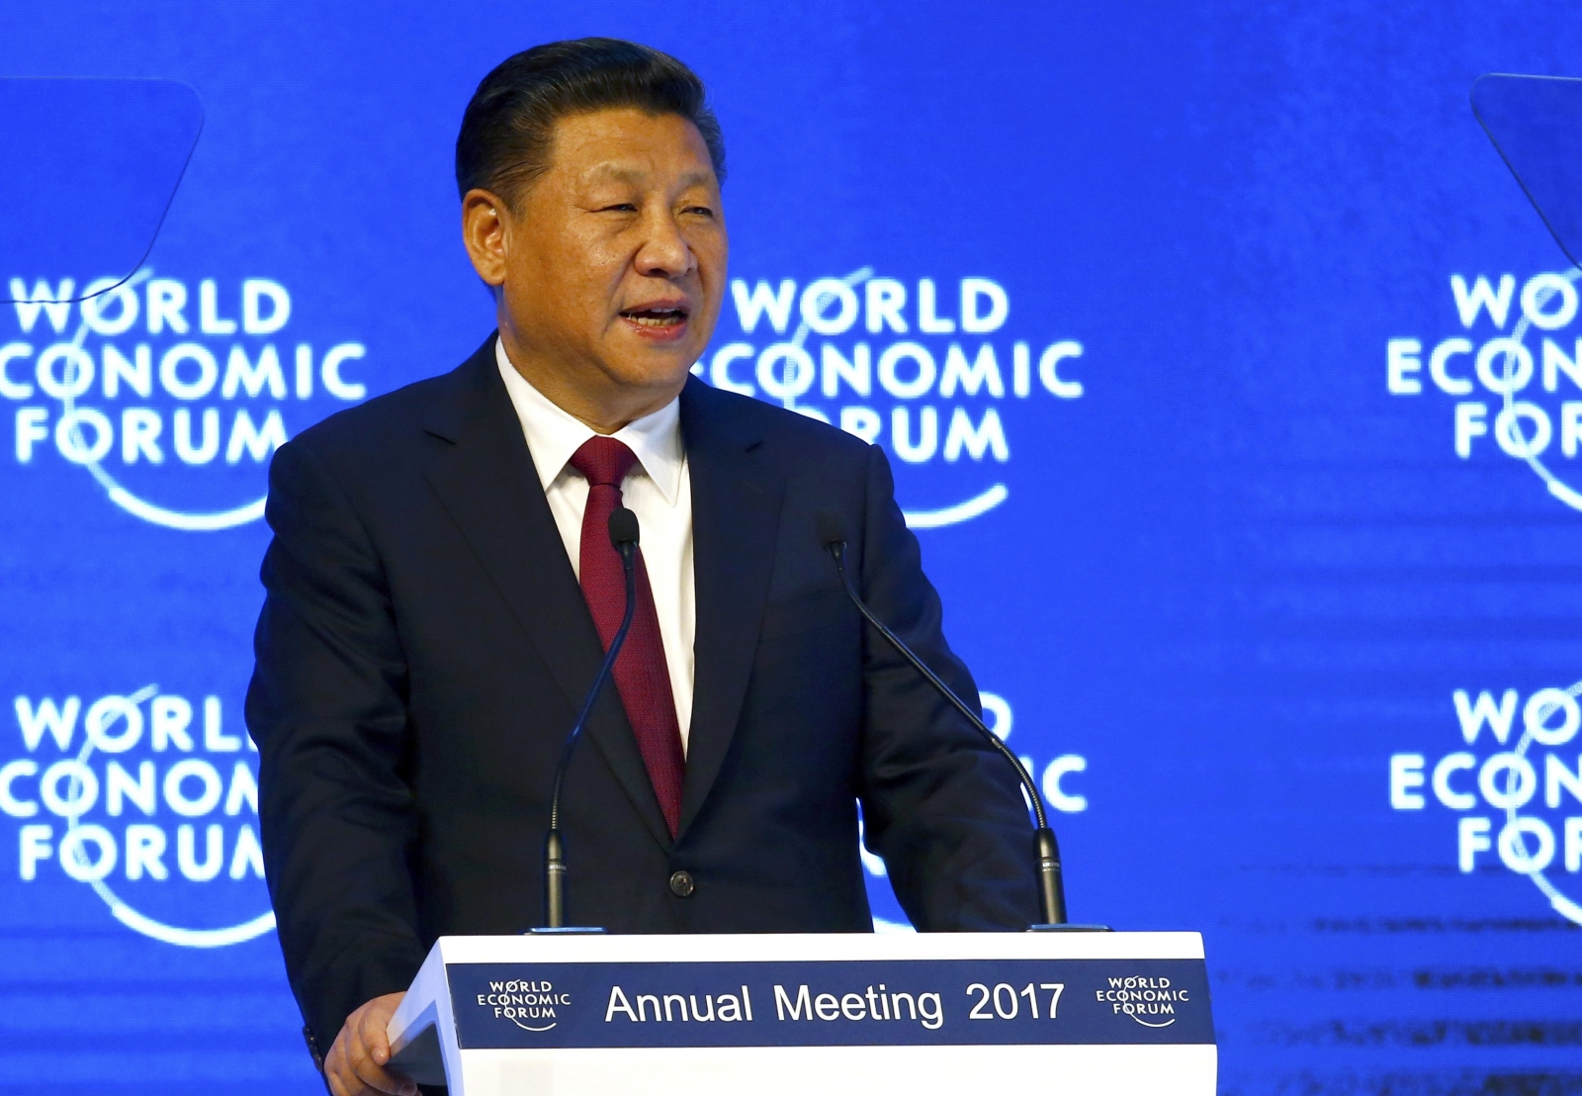
Why is self-regulation and ethics so important to China?
”China has the potential to become the world’s economic leader, as well as to take a leading role in issues related to environmental policy, trade policies and business ethics”
President Xi Jinping Speech to World Economic Forum, January 2017

Slide 6

The IFPMA Code is:
First established in 1981, last updated in 2012
Global standard for the R&D biopharmaceutical industry
A model of self-regulation for industry’s activities in medicines promotion, communication and interaction with
key stakeholders such as healthcare professionals, medical institutions and patient organizations.
Although self-regulatory, the IFPMA Code is not voluntary, it is a condition of membership to the IFPMA for both member companies and national associations.

Slide 7


Strong synergy between IFPMA Code and APEC Mexico City Principles
The Mexico City Principles (2011)

Slide 8
APEC members with(out) Codes
Over 5 last years steady growing number of Associations
and Member Companies with a Code

Slide 9
Role of national Codes in implementing international Standards
International
Regional
National
WHO “Ethical Criteria for Medicinal Drug Promotion” (1988)
IFPMA Code of Practice
Global Company Codes of Conduct
National laws with global reach (e.g. FCPA)
EFPIA Code of Practice
FIFARMA
Latin American Federation
APEC Mexico City Principles
National Code of Practice of IFPMA Affiliated Associations
National Company Codes of Conduct
Summary of different code and regulatory mechanisms applying to international pharmaceutical companies

Slide 10
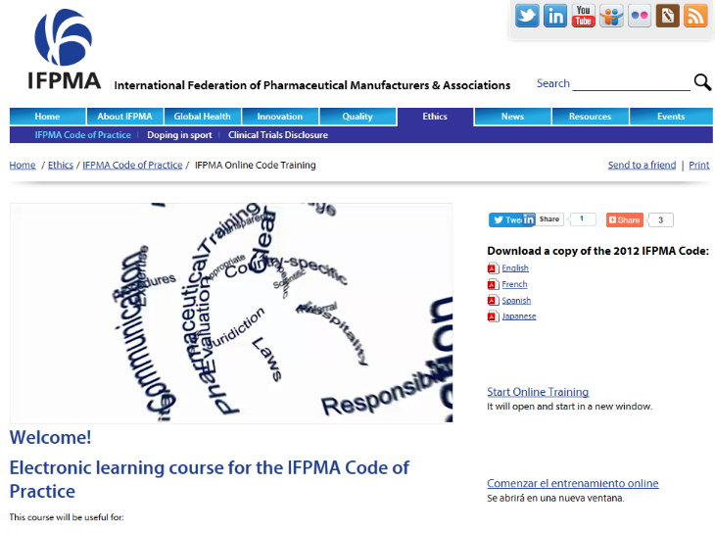
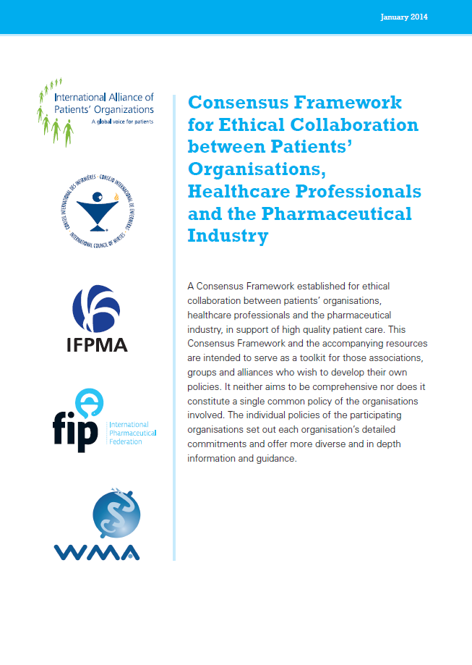

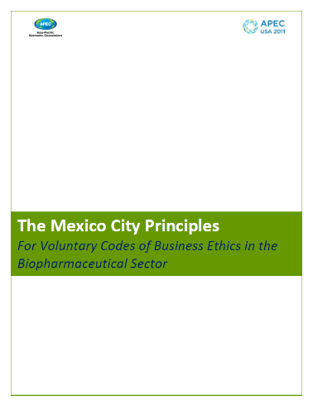
IFPMA support

Slide 11

Kenya: Recent example of
Code launch
Launched April 2016
Extensive work with local association (KAPI) and member companies
Revamped and updated local code
Communication with industry and stakeholders in Kenya

Slide 12
Different models for establishing a national industry Code
Model 1
Model 2
Model 3
National Association based
Outsourced to specialized Association
Mix of industry and national regulatory system

Slide 13
Suggested next steps
Reference existing standards (IFPMA Code, Mexico City Principles, Chinese national Code, …)
Look for models that will best work in your country and evaluate
Draft Code in consultation with local industry, government, other key stakeholders (incl. doctors groups, patient organizations).
Consider scope of areas to be covered, e.g. Marketing, interaction with patients, clinical trials, …
Launch and communicate

